Slide 1
National Airspace System
Objective |  | Purpose
To determine the applicant understands the National Airspace System, can apply that knowledge, manage associated risks, and demonstrate appropriate skills. |  | Every flight occurs in some class of airspace, whether you realize it or not. The rules can vary quite a bit between different classes of airspace, so it’s important that pilots understand how they fit into the System.
Student Actions | Instructor Actions | Schedule | Equipment
Review references prior to lesson | Deliver ground lesson Answer student questions | Ground lesson: 60 minutes Q&A: 15 minutes | References
Completion Standards
The applicant demonstrates and simultaneously explains how to: Identify and comply with the requirements for basic VFR weather minimums and flying in particular classes of airspace Correctly identify airspace and operate in accordance with associated communication and equipment requirements Identify the requirements for operating in SUA or within a TFR. Identify and comply with special air traffic rules (SATR) and SFRA operations, if applicable
Resources
Pilot’s Handbook of Aeronautical Knowledge (PHAK) (FAA-H-8083-25C), Chapter 15 Private Pilot Airplane ACS (FAA-S-ACS-6C), Area I Task E Commercial Pilot Airplane ACS (FAA-S-ACS-7B), Area I Task E CFI Airplane ACS (FAA-S-ACS-25), Area II Task G

Slide 2
Ground Lesson Outline
Defining Airspace
  Size and Shape
  Controlled, Uncontrolled, Special Use, and Other
Controlled Airspace
  Class A
  Class B
  Class C
  Class D
  Class E
Uncontrolled airspace
  Class G
VFR Weather Minimums and Special VFR
Special Use Airspace (SUA)
  Prohibited Areas
  Restricted Areas
  Warning Areas
  Military Operations Areas (MOA)
  Alert Areas
  Controlled Firing Area (CFA)
  National Security Area (NSA)
Other Airspace
  Temporary Flight Restrictions (TFR)
  Military Training Routes (MTR)
  Parachute Jump Operations
  VFR Flyways
  VFR Corridors
  Class B Airspace VFR Transition Routes
  Terminal Radar Service Areas (TRSA)
  Special Air Traffic Rules Area (SATR)
  Special Flight Rules Area (SFRA)
  Weather Reconnaissance Area (WRA)
  Air Defense Identification Zone (ADIZ)

Slide 3
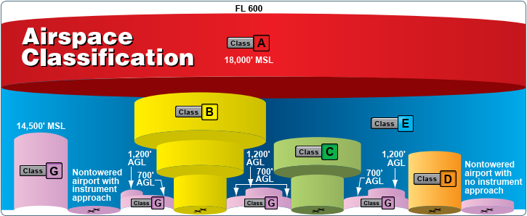
Defining Airspace
Size and Shape
Combination of lateral limits and altitude
Lateral limits may be arbitrary shape or radius around a point
Categories
Controlled, Uncontrolled, Special Use, and Other
Define restrictions, VFR weather minimums, required equipment, and pilot qualifications

Slide 4
Controlled Airspace
A generic term that covers the different classification of airspace (Class A, Class B, Class C, Class D, and Class E airspace) and defined dimensions within which air traffic control service is provided to IFR flights and to VFR flights in accordance with the airspace classification

Slide 5
Class A
Size and Shape | Between 18,000ft MSL and FL600 over the continental US, Alaska, and coastal waters out to 12nm
Chart Depiction | None
Pilot | IFR rated and current
Equipment | IFR rated and equipped airplane
Entry | ATC clearance on an IFR flight plan
Speed Limits | No supersonic
Altitude | Flight Vis | Cloud Clearance
All (IFR only) | None | None
Notes:
Flight levels and transition altitude

Slide 6
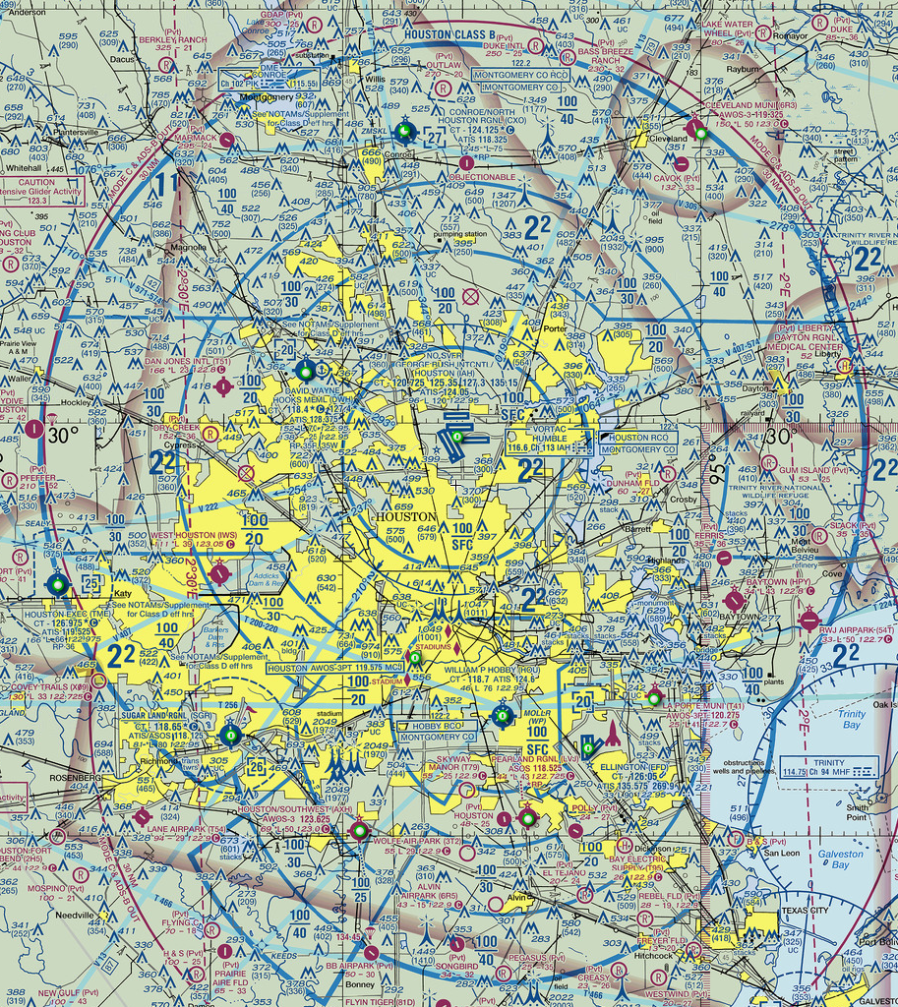
Class B
Size and Shape | Generally, surface to 10,000ft AGL surrounding major airports, with lateral limits designed to contain all instrument approaches for the primary airport; often shaped like an upside wedding cake.
Chart Depiction | Solid blue line
Pilot | Private pilot or student w/ endorsement
Equipment | Two-ray radio, altitude encoding transponder, ADSB-out
Entry | ATC clearance
Speed Limits | 250kts inside, 200kts below shelf
Altitude | Flight Vis | Cloud Clearance
All | 3sm | Clear of clouds
Notes:
Example or clearance vs not
Mode c = alt encoding xprd

Slide 7
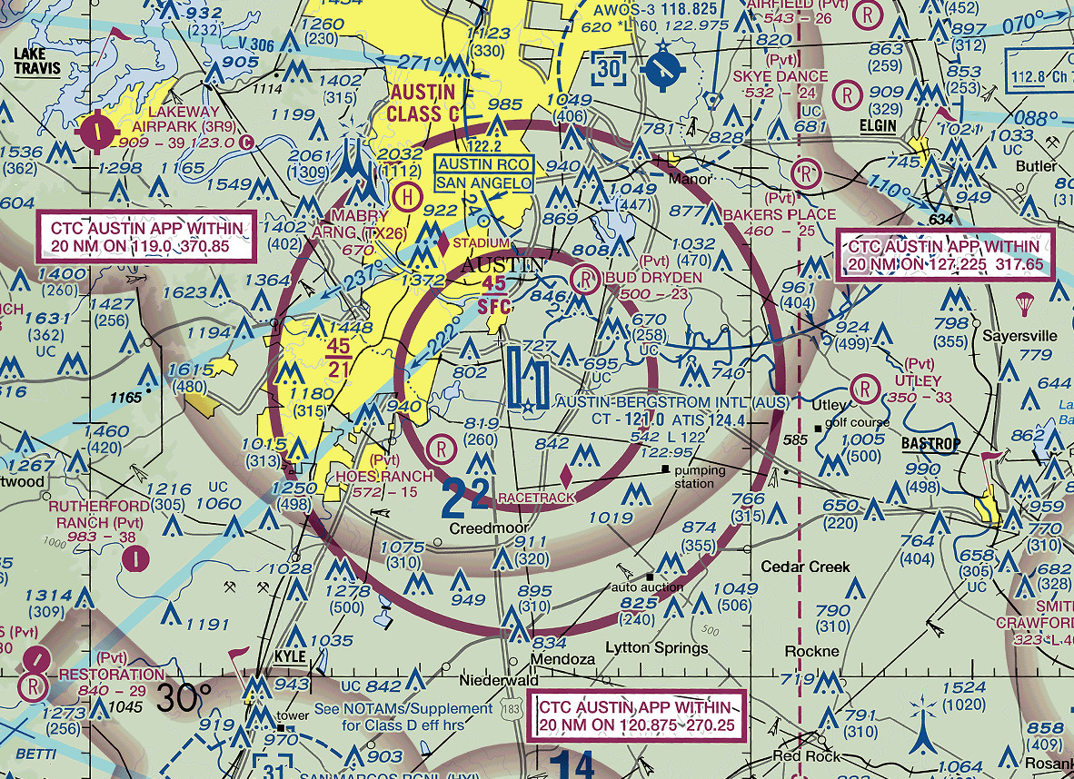
Class C
Size and Shape | Generally, surface to 4000ft AGL above the primary airport, with a 5nm inner core from surface to 4000ft AGL, and a 10nm outer shelf from 1200ft to 4000ft AGL above the primary airport; also has a 20nm uncharted ring.
Chart Depiction | Solid magenta line
Pilot | No specific requirements
Equipment | Two-ray radio, altitude encoding transponder, ADS-B out
Entry | Two-way communication
Speed Limits | 200kts <=2500ft AGL and within 4nm of primary airport; No supersonic
Altitude | Flight Vis | Cloud Clearance
All | 3sm | 1000ft above / 500ft below / 2000ft horizontal
Notes:
Also a non-charted 20nm ring that the tracon controls

Slide 8
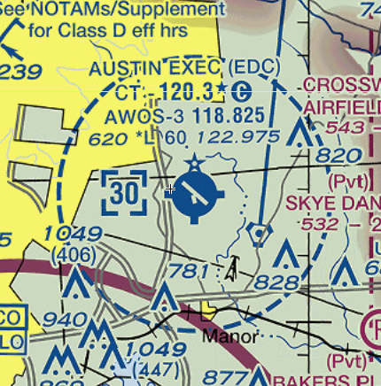
Class D
Size and Shape | Generally, surface to 2500ft AGL above the primary airport. May be part time, in which case it generally reverts to Class E.
Chart Depiction | Dashed blue line
Pilot | No specific requirements
Equipment | Two-ray radio
Entry | Two-way communication
Speed Limits | 200kts <=2500ft AGL and within 4nm of primary airport; No supersonic
Altitude | Flight Vis | Cloud Clearance
All | 3sm | 1000ft above / 500ft below / 2000ft horizontal

Slide 9
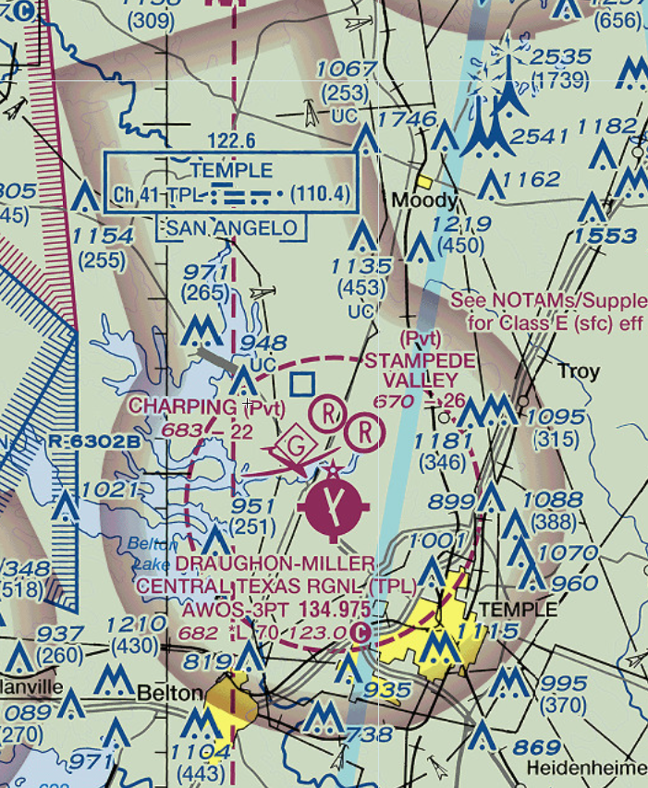
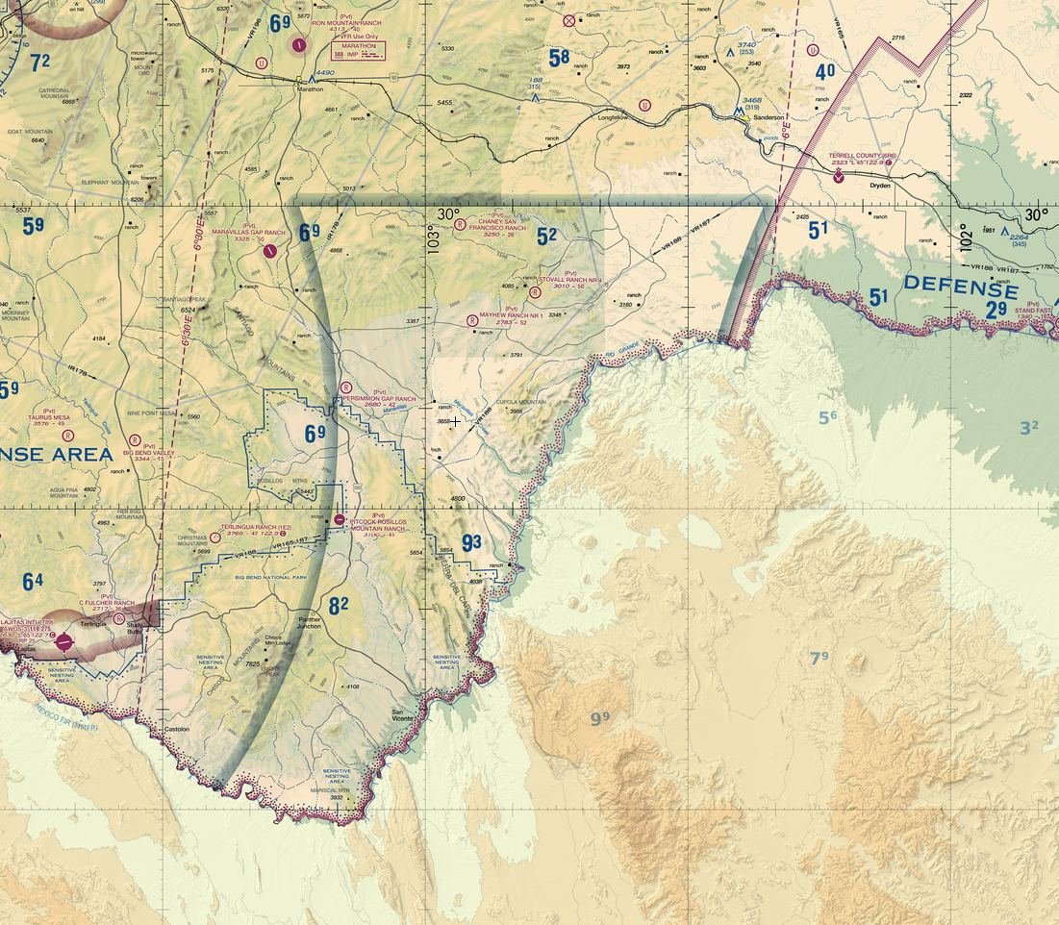
Class E
Size and Shape | All controlled airspace that is not Class A, B, C, or D; E = everywhere else. Unless otherwise depicted, begins at 14,500ft MSL and extends up to but not including FL180, then again at FL600. In all practicality, it usually starts at 1200ft AGL, with a few exceptions (e.g. Big Bend, Alaska).
Chart Depiction | Dashed magenta line: starts at surface Magenta vignette: starts at 700ft AGL Blue vignette: starts at 1200ft AGL (assume all of US enclosed in blue vignette)
Pilot | No specific requirements
Equipment | <10,000ft MSL: none >=10,000ft MSL: altitude encoding transponder, ADS-B out
Entry | None for VFR
Speed Limits | 250kts below 10,000ft MSL; 200kts if below Class B shelf
Altitude | Flight Vis | Cloud Clearance
<10,000ft MSL | 3sm | 1000ft above / 500ft below / 2000ft horizontal
>=10,000ft MSL | 5sm | 1000ft above / 1000ft below / 1sm horizontal
Notes:
All controlled airspace that is not Class A, B, C, or D; E = everywhere else. Unless otherwise depicted, begins at 14,500ft MSL and extends up to, but not including, FL180 MSL. In all practicality, it usually starts at 1200ft AGL, with a few exceptions (e.g. Big Bend, Alaska). Generally, surrounding untowered airports to protect the airspace for instrument procedures, in which case the Class E airspace begins at either 700ft or 1200ft AGL. Class E also begins again above FL600 to an undefined upper limit.

Slide 10
Uncontrolled Airspace
That portion of airspace that has not been designated as Class A, Class B, Class C, Class D, or Class E airspace

Slide 11
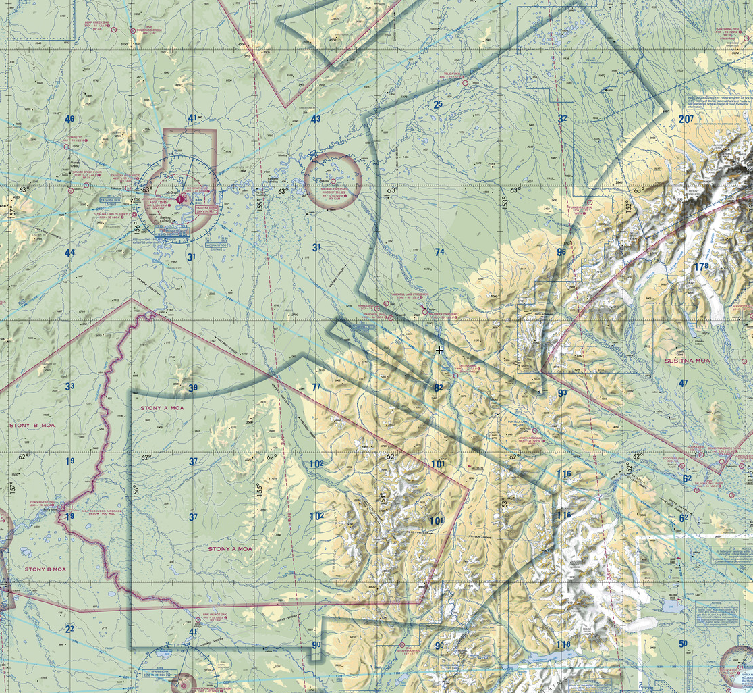
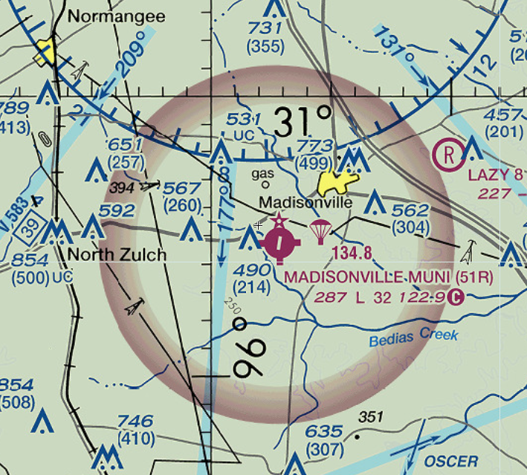
Class G
Size and Shape | Generally, extends from the surface to the base of the overlying Class E airspace. Any airspace that is not Class A, B, C, D, or E is Class G
Chart Depiction | Not explicitly depicted
Pilot | No specific requirements
Equipment | <10,000ft MSL: none >=10,000ft MSL and >2500ft AGL: altitude encoding transponder, ADS-B out
Entry | None
Speed Limits | 250kts below 10,000ft MSL 200kts if below Class B shelf
Altitude | Flight Vis | Cloud Clearance
<1200ft AGL day | 1sm | Clear of clouds
<1200ft AGL night | 3sm | 1000ft above / 500ft below / 2000ft horizontal
>=1200ft AGL day | 1sm | 1000ft above / 500ft below / 2000ft horizontal
>=1200ft AGL night | 3sm | 1000ft above / 500ft below / 2000ft horizontal
>1200ft AGL and >=10,00ft MSL | 5sm | 1000ft above / 1000ft below / 1sm horizontal
91.155(b) exception: If the visibility is less than 3sm but not less than 1sm during night and you are operating in an airport traffic pattern within 1⁄2 mile of the runway, you may operate an airplane clear of clouds
Class G airspace to, but not including, 14,500ft MSL depicted on the hard side (inside) the blue Class E vignette
Class G up to, but not including, 700ft AGL inside the magenta vignette
Up to, but not including, 1200ft outside the magenta vignette

Slide 12
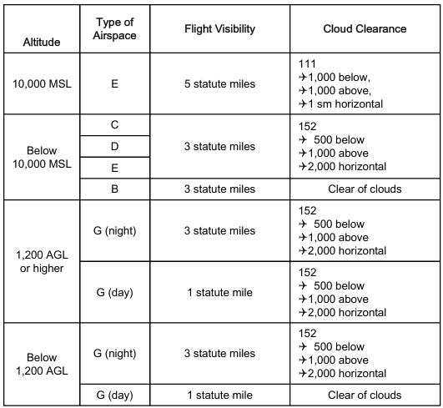
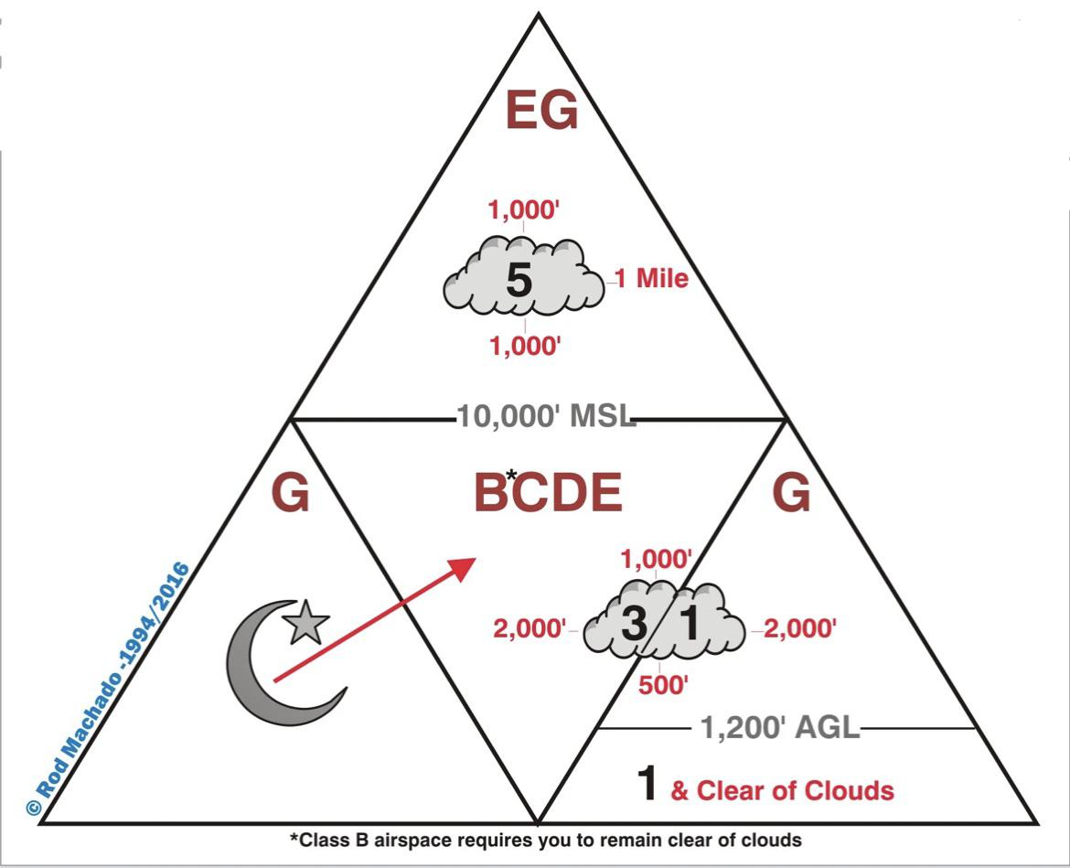
Airspace Vis and Cloud Clearance Summary

Slide 13
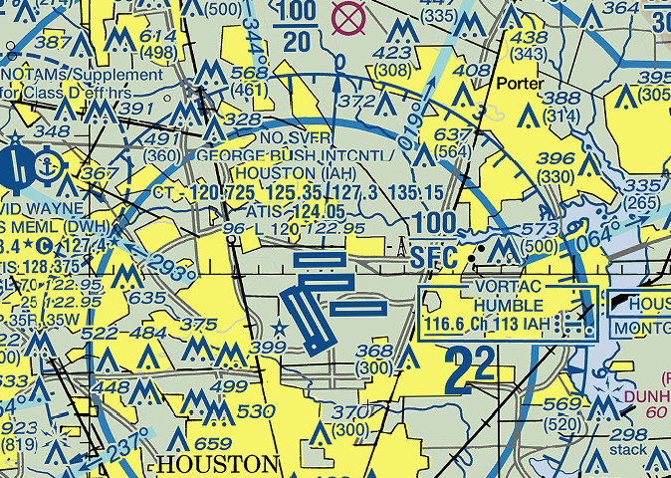
Special VFR (SVFR)
If weather is less than the basic VFR minimums in 91.155 (3sm, 1000ft) in a Class B/C/D/E surface area, pilots may request an SVFR clearance to enter, leave, or operate within the surface area
Generally issued at most Class D/E, while not allowed at many Class C and most Class B due to traffic; this restriction will be depicted on the sectional
Weather minimums (day)
  1sm flight visibility within Class B/C/D/E surface areas, clear of clouds
  1sm ground visibility if taking off or landing (use flight visibility if no ground visibility reported), clear of clouds
  Helicopters just remain clear of clouds
At night, plane and pilot must be IFR capable and current (might as well file IFR?)

Slide 14
Rocket Ship Game

Slide 15
Special Use Airspace
Airspace wherein activities must be confined because of their nature, or wherein limitations are imposed upon aircraft operations that are not a part of those activities, or both

Slide 16
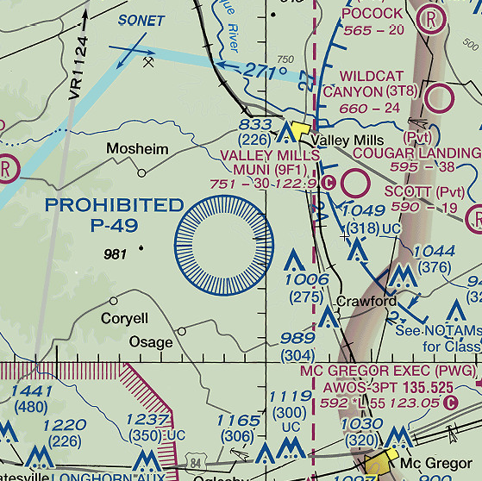
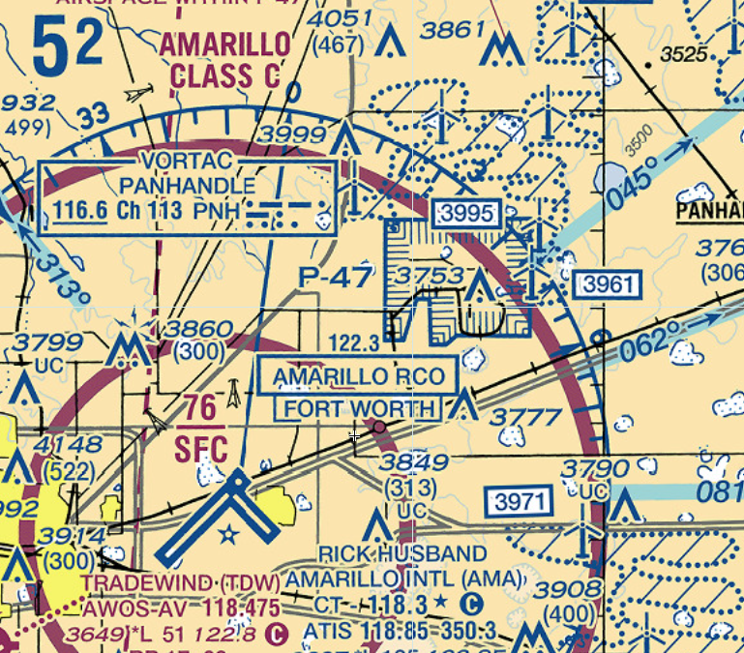
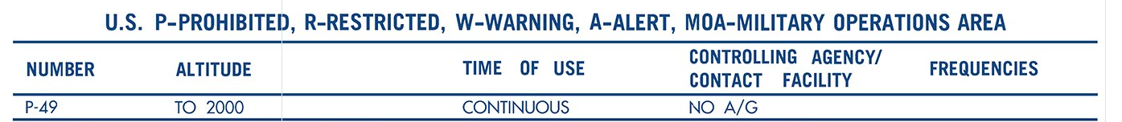
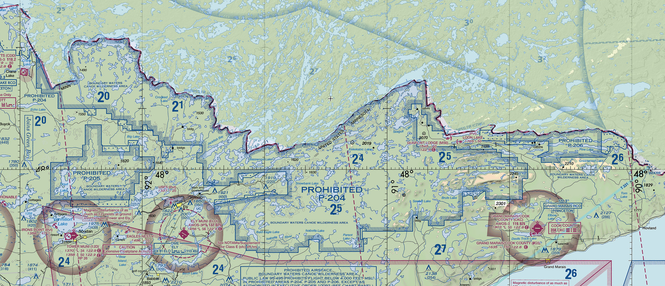
Prohibited Areas
Typically, sensitive national security areas
Flight is strictly prohibited!
Marked by blue fringe
More info on sectional chart legend

Slide 17
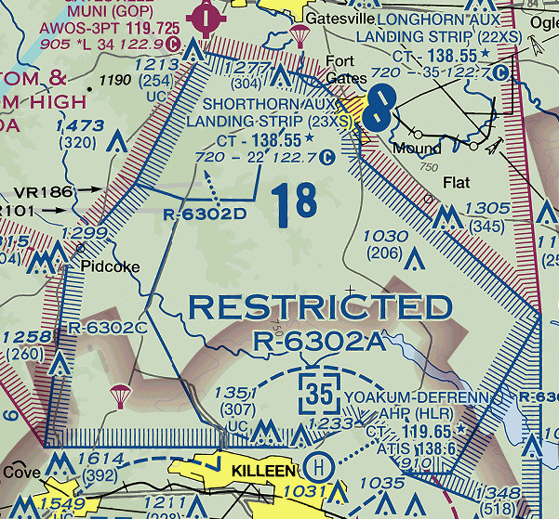
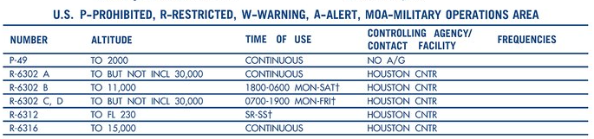
Restricted Areas
Operations may be hazardous to non-participating aircraft (that’s you!)
For IFR flights, ATC will keep you clear of the airspace if it's active or route you through if it’s inactive
VFR flights should coordinate with ATC beforehand for permission
Marked by blue fringe
More info in sectional chart legend

Slide 18
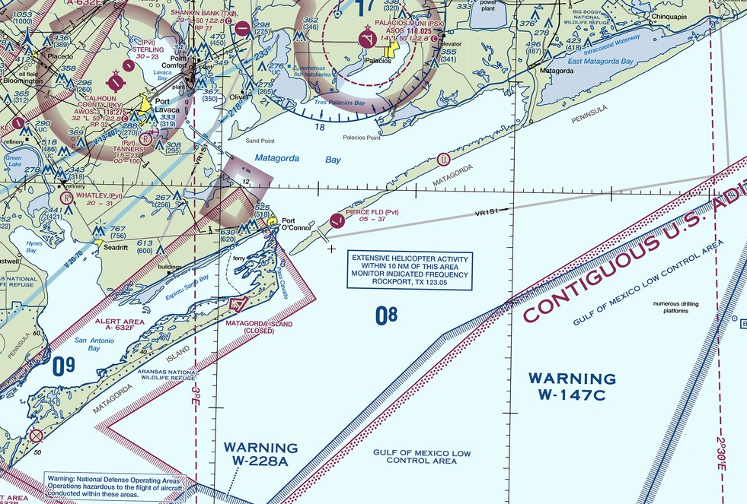
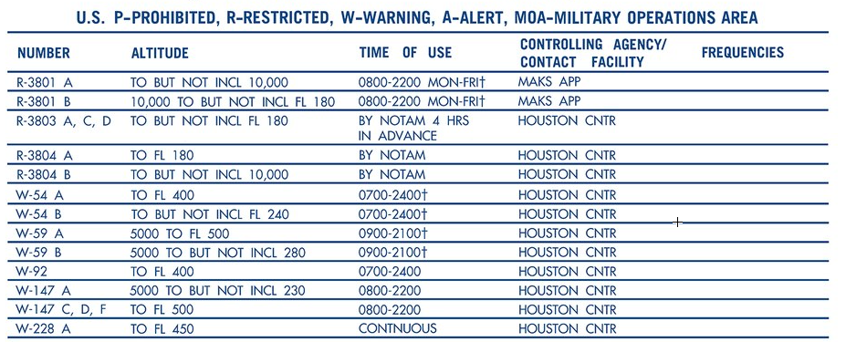
Warning Areas
Like restricted areas but located 3nm beyond the coast over water where US government does not have sole jurisdiction over the airspace
Non-regulatory, so no specific ATC clearance or coordination is required, but you should use extreme caution regardless
Marked by blue fringe
More info in sectional chart legend

Slide 19
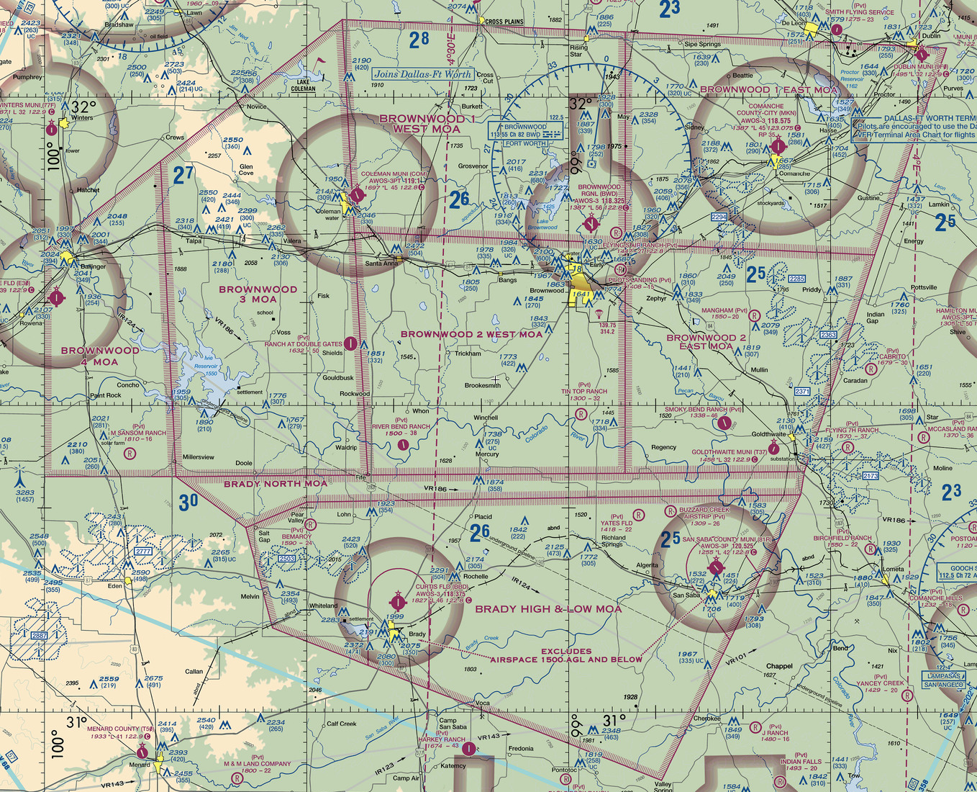
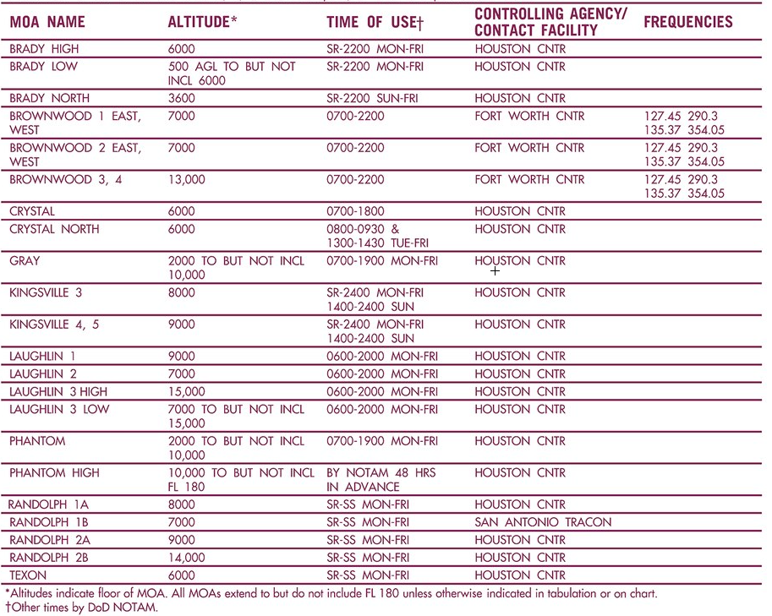
Military Operations Areas (MOA)
Typically used for military flight training
Military traffic is exempt from most regulations over speed, aerobatics, formation flying, etc.
When active, IFR traffic may be cleared through if ATC can maintain separation. Otherwise, IFR traffic will be routed around the MOA
VFR traffic is technically permitted any time, but it’s generally not a good idea and extreme caution should be exercised
ATC or FSS can advise if the MOA is active
Marked by magenta fringe
More info on sectional chart legend

Slide 20
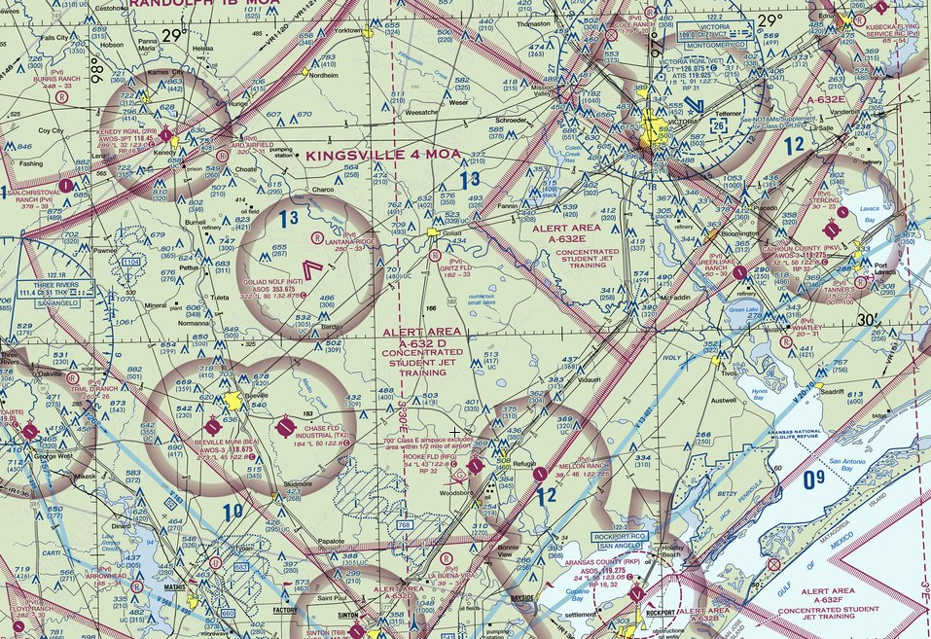
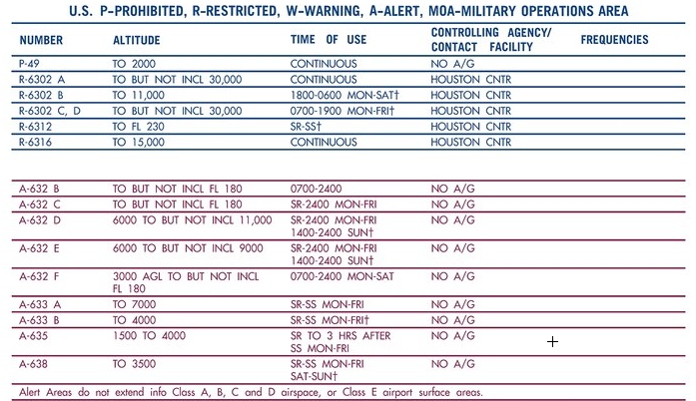
Alert Areas
Typically, around military airfields where training takes place or other activities hazardous to non-participating aircraft
No specific clearance is required
All pilots (military and civilian) are required to abide by the FARs
Marked by magenta fringe
More info on sectional chart legend
Notes:
Gulf coast helicopters
Fort dix

Slide 21

Controlled Firing Area (CFA)
Areas where activities would be hazardous to nonparticipating aircraft (that’s you!)
Activities are suspended upon detection of a nonparticipating aircraft, so there is no need to chart these areas

Slide 22
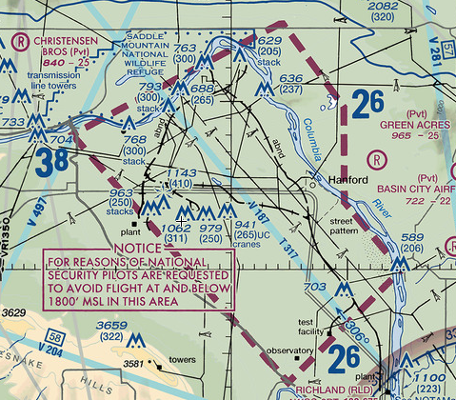
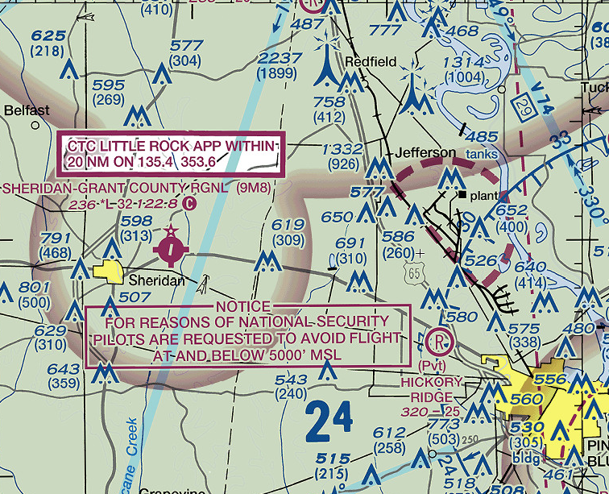
National Security Area (NSA)
Areas where pilots are requested to voluntarily avoid flight, typically due to national security
May be temporarily converted to prohibited areas by NOTAM
Marked by thick magenta dashed line

Slide 23
Other Airspace

Slide 24
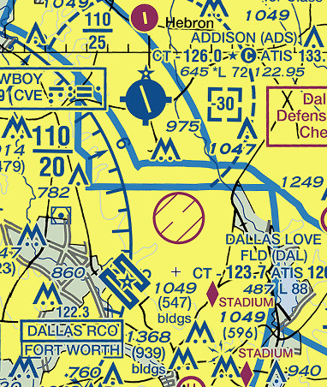
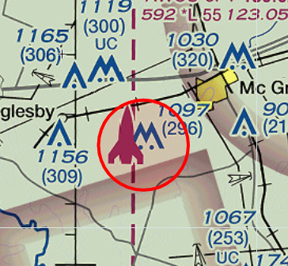
Temporary Flight Restrictions (TFR)
Issued by the FAA via NOTAM due for security, safety, disaster response, or other reasons
Aircraft may be cleared through by ATC using a discrete squawk for each aircraft.
Some are charted if they have no defined end time

Slide 25
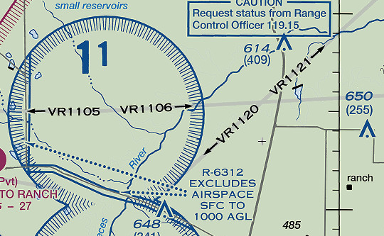
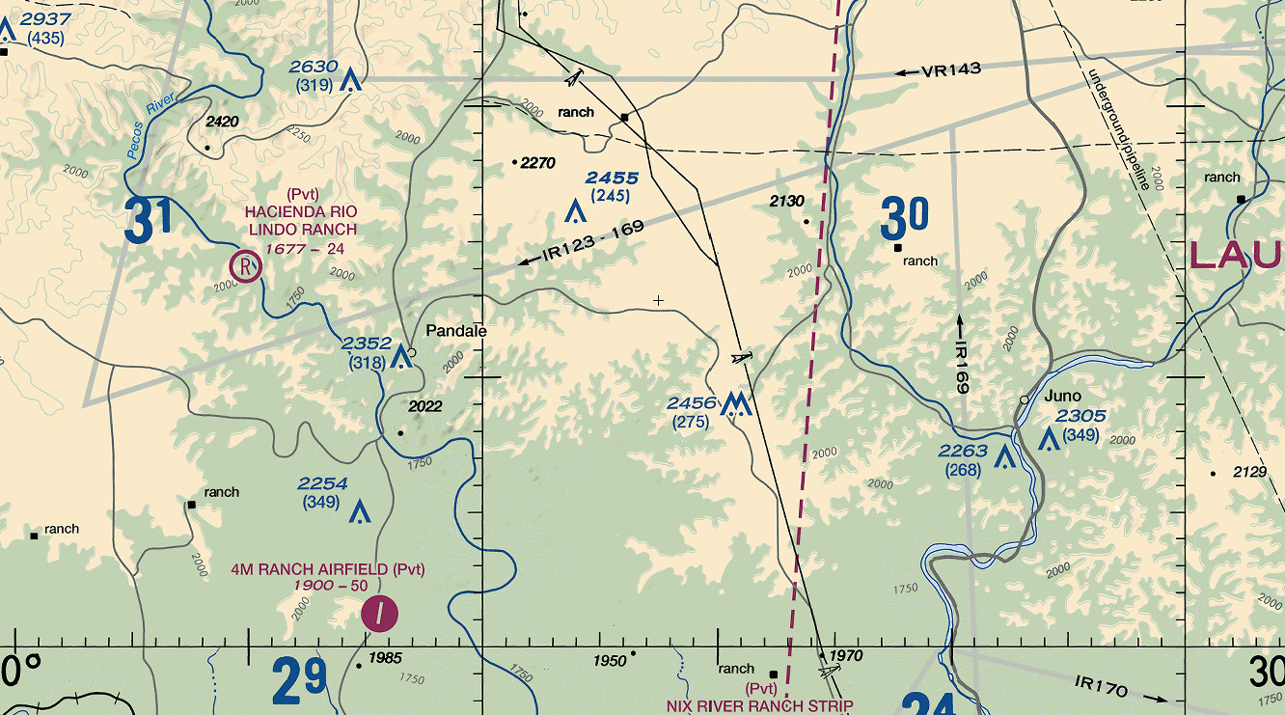
Military Training Routes (MTR)
Low-level, high-speed routes used by the military for training
May be VFR (VR) or IFR (IR)
Routes under 1500ft AGL denoted by IR/VR and four numbers (e.g. IR1234)
Routes above 1500ft AGL denoted by IR/VR and three numbers (e.g. VR567)
No flight restrictions for nonparticipating aircraft, but extreme caution should be used
Marked by faint gray line

Slide 26
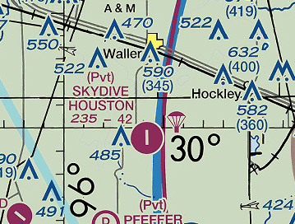
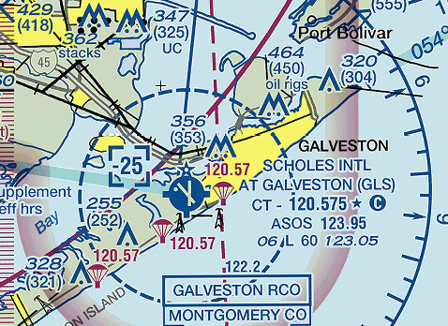
Parachute Jump Operations
Areas of frequent parachute (i.e. skydiving) operations
Skydive pilots will generally announce on center or CTAF frequencies their intentions and status
Specific frequency could also be charted

Slide 27
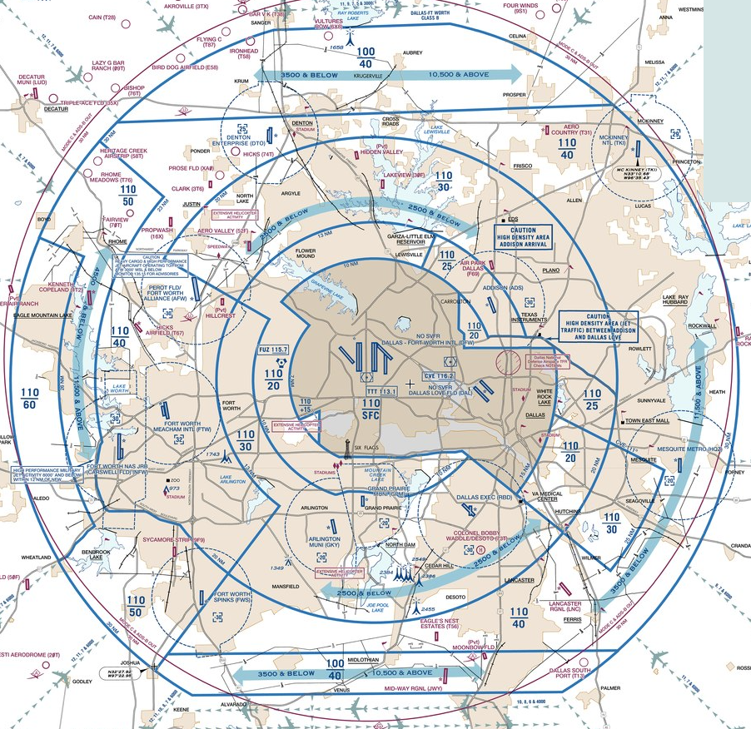
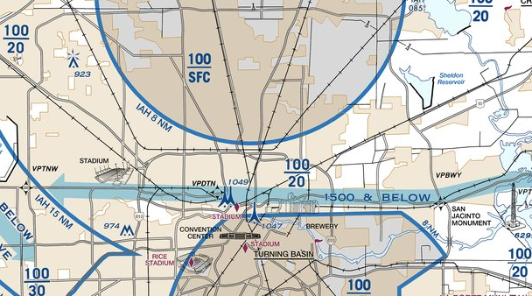
VFR Flyways
General flight paths, that don’t follow a specific course, that VFR pilots can use to fly into, out of, or around complex airspace that avoids entering the adjacent Class B airspace
For example, flying to an airport beneath the Class B shelf in a large city
ATC clearance is not required since they are outside of the Class B
Depicted on the reverse side of VFR TACs with a thick blue translucent line

Slide 28
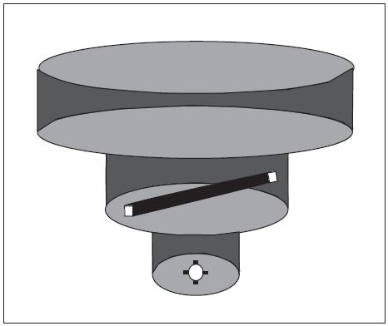
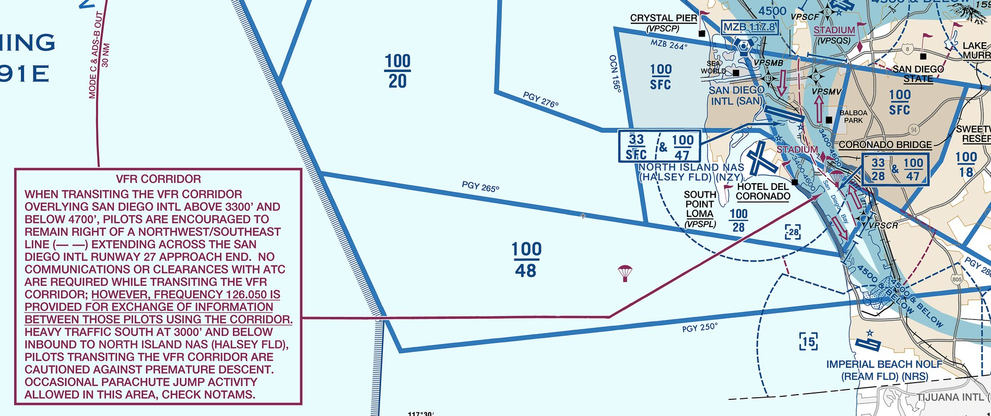
VFR Corridors
Specific flight paths defined by vertical and lateral limits that provide a corridor through Class B airspace
Think of these as tunnels bored through the Class B that you can use without an ATC clearance
Although no clearance is required, you should remain extremely vigilant because you are surrounded on all sides by the Class B
Depicted on VFR TACs with a thick blue translucent line

Slide 29
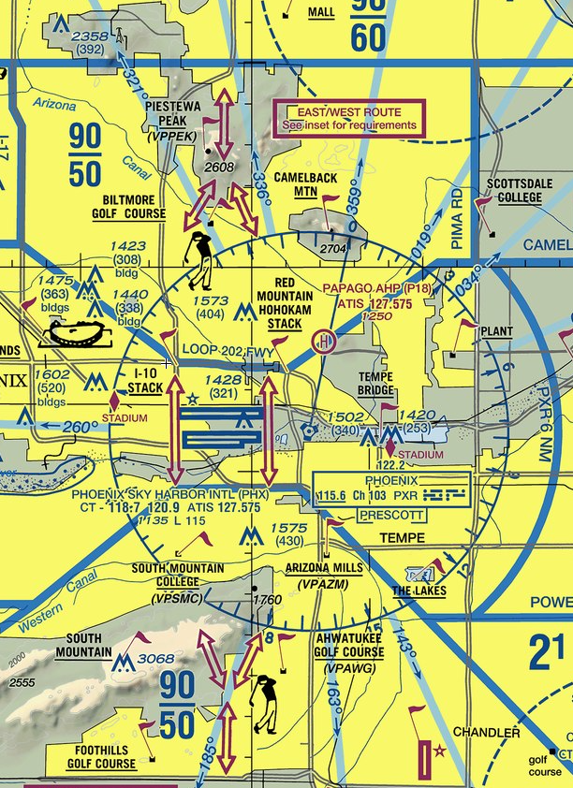
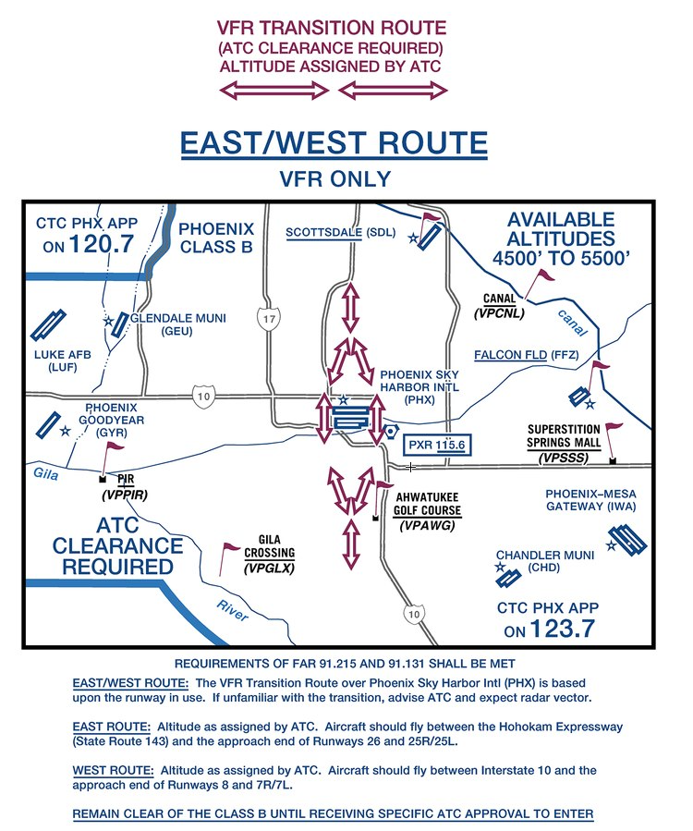
Class B Airspace VFR Transition Routes
Predefined routes that VFR pilots can use to transition Class B when on an ATC clearance
These exist to expedite VFR traffic transiting Class B, as you and ATC already know the path to you will take
ATC will assign the specific altitude
Depicted on VFR TACs with hollow magenta arrows

Slide 30
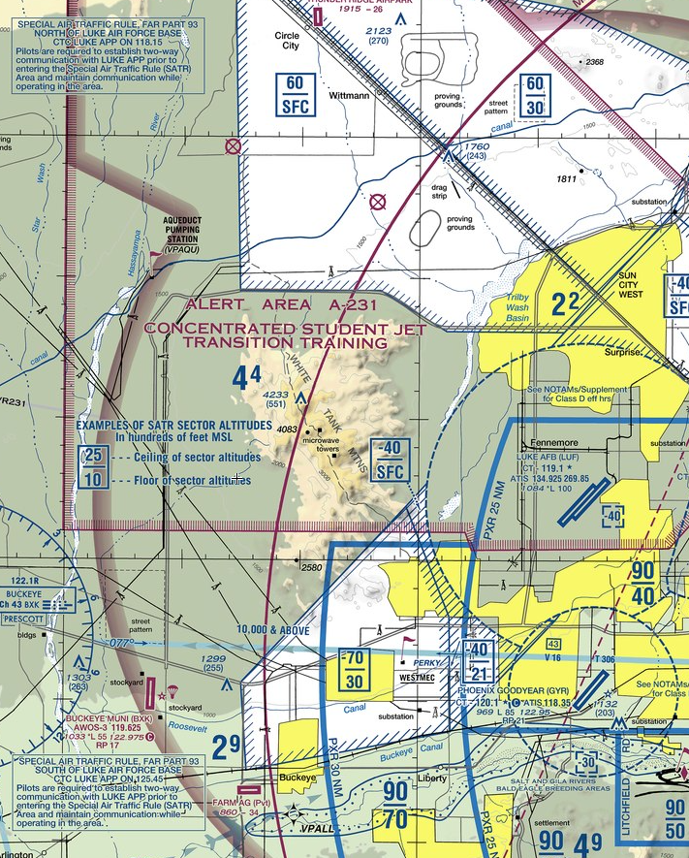
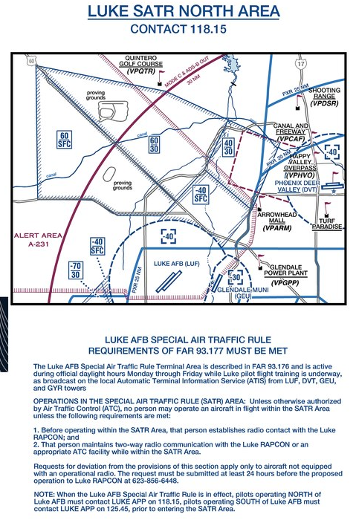
Special Air Traffic Rules (SATR) Area
Areas where specific rules are established, and the normal rules may or may not apply
Compliance is mandatory for everyone
Marked by a blue slashed line

Slide 31
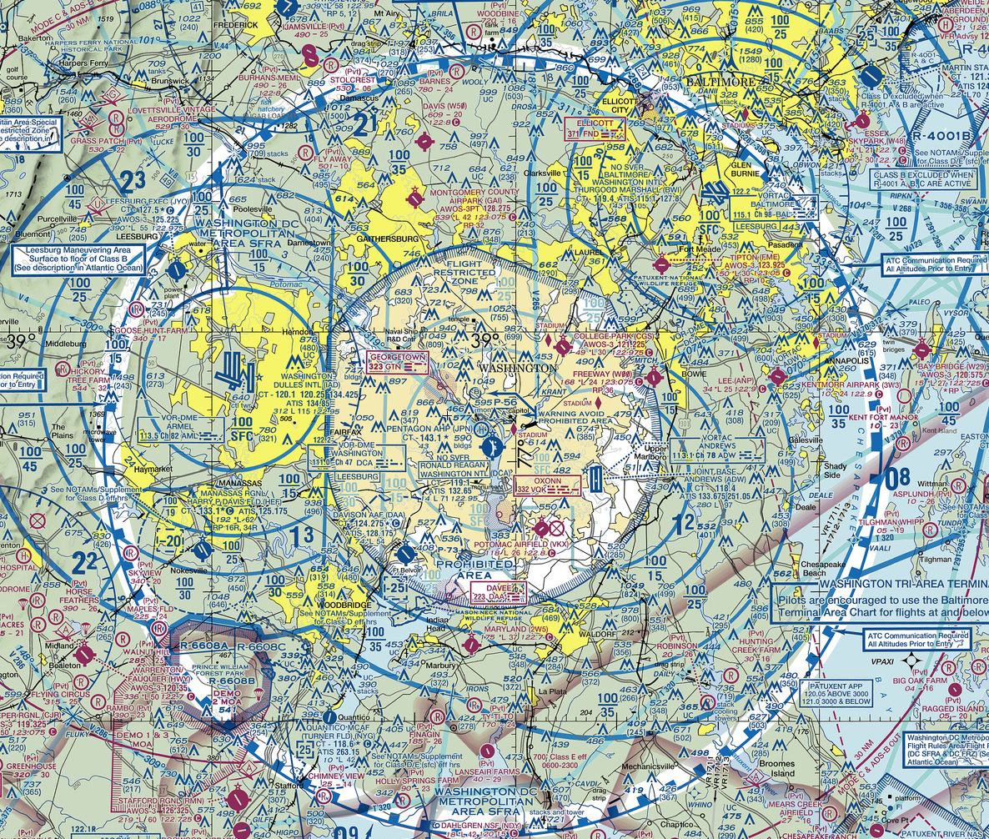
Special Flight Rules Area (SFRA)
Areas where specific rules are established, and the normal rules may or may not apply
ATC pre-clearance is required, and pilots must have special training (e.g. an online course)
Marked by a blue blocked line

Slide 32
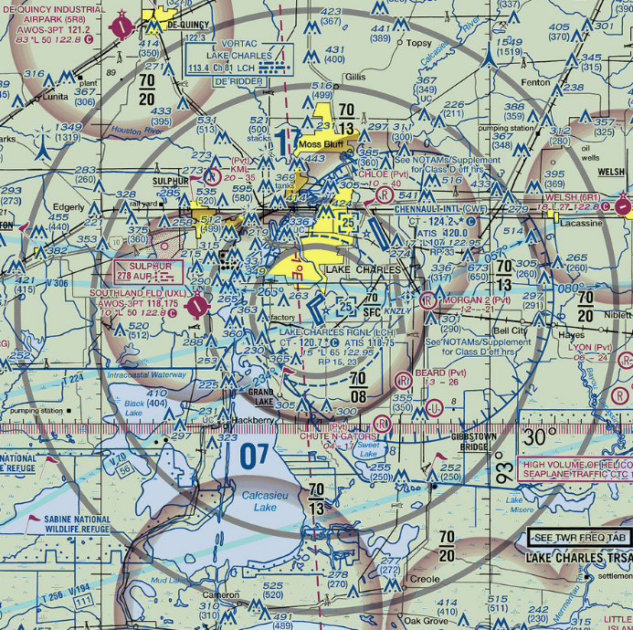
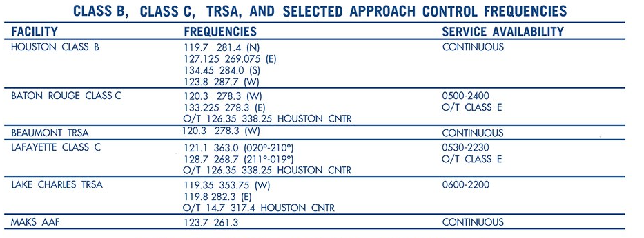
Terminal Radar Service Areas (TRSA)
Busy Class D airspace may have a TRSA where you can receive additional radar services and IFR/VFR traffic separation from ATC
VFR aircraft participation in the TRSA is voluntary, but highly encouraged
Marked by gray lines
Frequency info in sectional chart legend

Slide 33
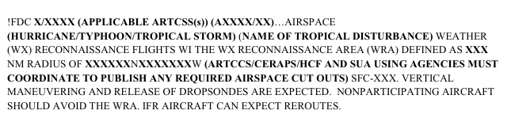
Weather Reconnaissance Area (WRA)
Areas established by NOTAM around hurricanes where USAF and NOAA aircraft (Hurricane Hunters) are operating
IFR aircraft will be routed around WRAs, and VFR aircraft should avoid the area (why wouldn't you?!)

Slide 34
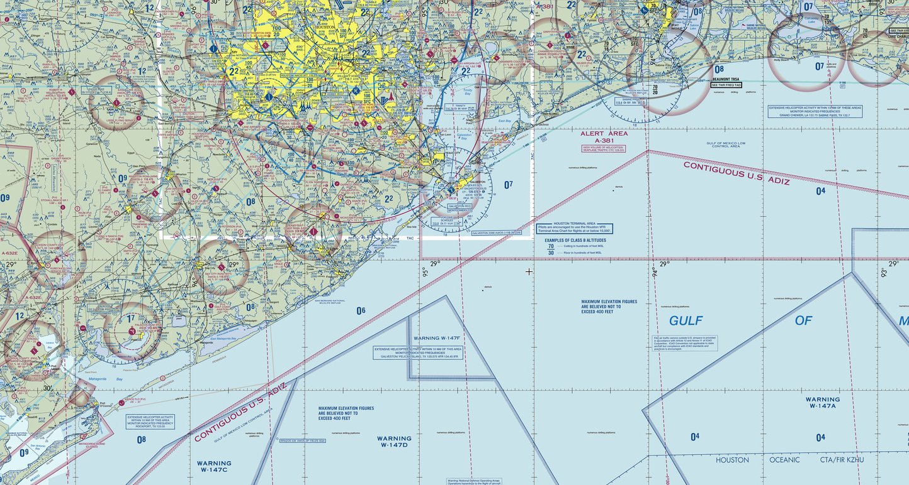
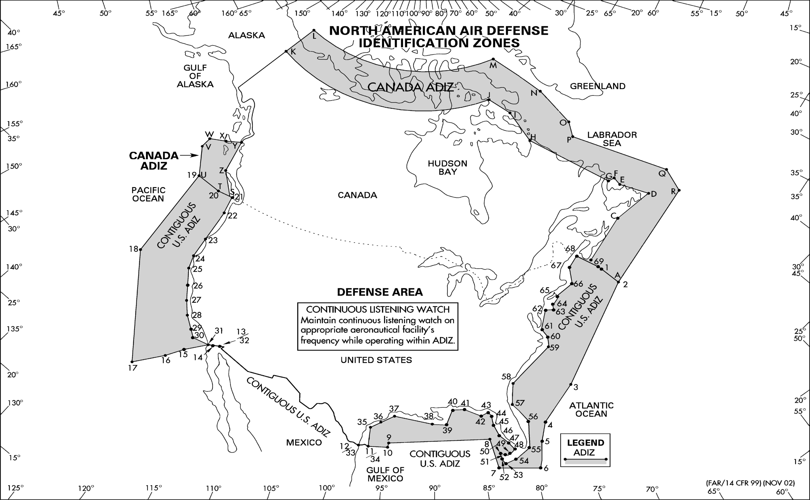
Air Defense Identification Zone (ADIZ)
Airspace over land or water, in which the ready identification, location, and control of all aircraft (except Department of Defense and law enforcement aircraft) is required in the interest of national security
Must be on a flight plan and be equipped with a two-way radio and transponder
VFR flights must file a Defense VFR (DVFR) flight plan that includes estimated time and location of ADIZ penetration (see AIM 5-1-8)

Slide 35
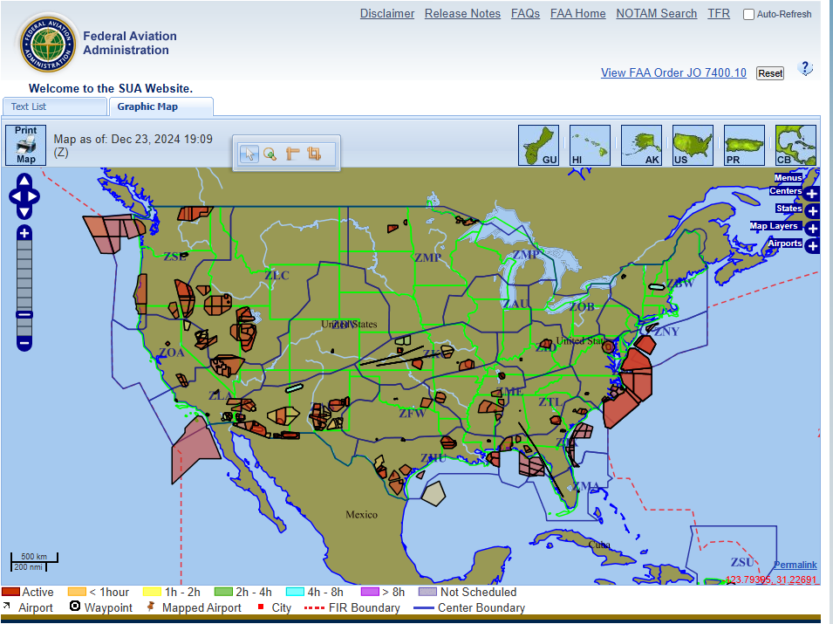
SUA Website
https://sua.faa.gov/

